Slide 1
Smile guru report
WELCOME TO

Slide 2
INDEX
1) OVERVIEW.
2) DATA IMPORT AND INITIAL SETUP.
3) INITIAL ANALYSIS.
4) HANDLING MISSING VALUES AND DATA TYPES ADJUSTMENTS.
5) ADDITIONAL ENANCEMENTS.
6) Smile Guru Dashboard Report.
7) DASHBOARD ANALYSIS.
8) CONCLUSION.

Slide 3
Overview
Objective: To analyze user engagement, device usage, and event distribution on SmileGuru's website.
Tools Used: Power BI, MySQL Workbench.
Data Source: SmileGuru Web Analytics Data.

Slide 4
Data import and initial setup
The dataset was imported into MySQL Workbench with all columns initially set as “TEXT” to prevent data loss.
Data types were later refined based on appropriate transformations.

Slide 5
Initial analysis
This dataset has the information about “smile guru” website engagement data.
There are 1,059 rows and 7 columns in the given dataset.
Findings of missing values and invalid_timestamp :
event_timestamp: 65 occurrences of "invalid_timestamp"
event_date: 103 occurrences of missing values
event_name: 91 occurrences of missing values
user_pseudo_id: 100 occurrences of missing values
device_category: 109 occurrences of missing values
device_os: 91 occurrences of missing values
page_location: 109 occurrences of missing values

Slide 6
Handling Missing values and data types adjustments
event_date (DATE):
All rows had the same values. Missing values were replaced with the existing value.
Data type converted from TEXT to DATE.
event_name (VARCHAR):
Missing values were replaced proportionally based on the frequency distribution of existing values.
Data type changed to VARCHAR.

Slide 7
user_pseudo_id (VARCHAR):
Missing values replaced with ‘unknown’.
Data type changed to VARCHAR.
device_os (VARCHAR):
Missing values were replaced proportionally based on the existing distribution of values.
Data type changed to VARCHAR.

Slide 8
device_category (VARCHAR):
Missing values were replaced proportionally based on existing value distribution.
Data type changed to VARCHAR.
event_timestamp (BIGINT):
Missing values were replaced proportionally based on existing values.
Data type changed to BIGINT.
page_location (VARCHAR):
Missing values were replaced with ‘https://smileguru.com’, assuming all visitors land on the main website first.
Data type retained as VARCHAR.

Slide 9
Additional Enhancements
Unique ID Column (ID):
A new column ‘ID’ was created to serve as a unique identifier.
Values were auto-incremented from 1 to 1059.
Page Column (VARCHAR):
A new column ‘page’ was derived from page_location.
If the page_location was ‘https://smileguru.com’, the value was set to ‘main’.
For all other URLs, the specific page details were extracted.

Slide 10
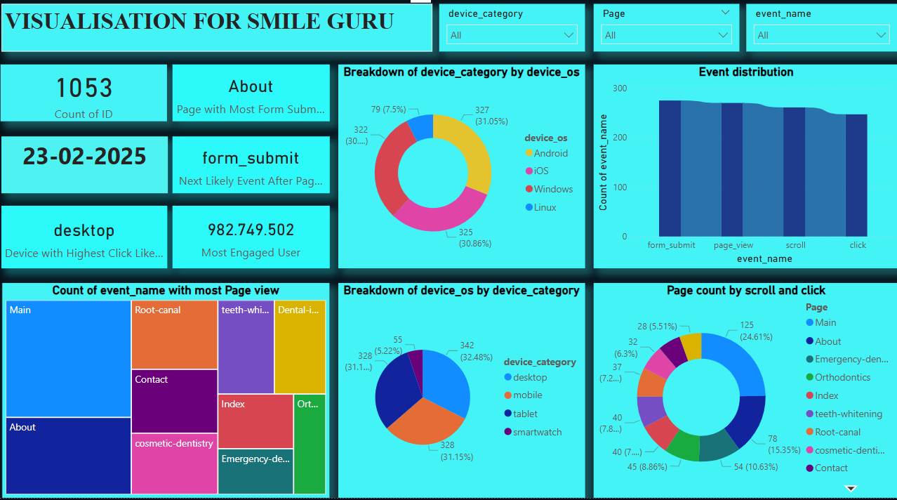
Smile Guru Dashboard Report

Slide 11
Device and OS Usage
Device OS Breakdown:
Android: 30.78%
iOS: 31.16%
Windows: 30.59%
Linux: 7.46%
Device Category Breakdown:
Desktop: 32.39%
Mobile: 31.35%
Tablet: 31.07%
Smartwatch: 5.19%
Insight: Users predominantly access the website via mobile and desktop devices.

Slide 12
Event Distribution
Top Events Recorded:
Form Submissions (most frequent action)
Page Views
Scroll Events
Clicks
Insight: Users are highly engaged in submitting forms and navigating different pages.

Slide 13
Page Popularity
Most Visited Pages:
Main Page
About Page
Root Canal
Contact Page
Teeth Whitening
Dental Implants
Emergency Dentistry
Insight: The Main and About pages drive the most user traffic, followed by service-related pages.

Slide 14
Scroll and Click Analysis
Pages with Highest Scroll and Click Events:
Main Page: 24.75%
About Page: 15.32%
Contact Page: 10.61%
Root Canal & Cosmetic Dentistry: Moderate engagement
Insight: Users tend to engage the most with the homepage and service-related content.

Slide 15
Overview of Key Metrics
Total Users (ID Count): 1053
Device with Highest Click Likelihood: Desktop
Most Engaged User ID: 982,749.502
Page with Most Form Submissions: About
Next Likely Event After Page View: Form Submit

Slide 16
Conclusion
The analysis provides insights into user behavior and areas for improvement.
Implementing optimizations based on this data can enhance user experience and conversions.
Mobile and desktop are the most used devices.
Form submissions and page views are dominant engagement metrics.
Optimize the website for mobile and desktop users.

Slide 17
Thank you

